Slide 1


Slide 2

HR PLANNING & JOB ANALYSIS
Notes:
The incidence of both lower incomes due to economic crisis and persistent high food prices has proved to be a devastating combination for the world’s most vulnerable populations.

Slide 3
Basic HRM Functions
To Obtain
To Develop
HRM
Functions
To Retain
To Utilize
Notes:
The incidence of both lower incomes due to economic crisis and persistent high food prices has proved to be a devastating combination for the world’s most vulnerable populations.

Slide 4
Basic HRM Functions
To obtain – to get required number / type of persons (HR) internally or through external hiring.
To develop – to train HR to be able to perform their jobs successfully.
To utilize – to get desired performance / results.
To retain – to hold them in org / project team.
Notes:
The incidence of both lower incomes due to economic crisis and persistent high food prices has proved to be a devastating combination for the world’s most vulnerable populations.

Slide 5
Line and Staff Authority
  Authority: Rights to make decisions, direct others’ work and give orders.
  Line Authority: Authority exerted by HR manager by directing activities of people in his/her own department.
  Staff Authority: Rights/authority given to a manager to advise other managers /employees - has advisory and consulting role. All HRM functional units including HRD have staff authority.
    Line Manager: A manager who is authorized to direct the work of subordinates & is responsible to achieve firm’s goals.
    Staff Manager: A manager who assists and advises line managers.
Notes:
The incidence of both lower incomes due to economic crisis and persistent high food prices has proved to be a devastating combination for the world’s most vulnerable populations.

Slide 6
Line and Staff Authority
    Implied Authority: The authority exerted by HR manager by virtue of others knowledge that he/she has access to top Mgt.
    Functional Authority / Functional Control: Authority to act as a coordinator of personnel activities. Here HR manager ensures that line managers are implementing the firm’s policies and practices (sort of a monitor).
Notes:
The incidence of both lower incomes due to economic crisis and persistent high food prices has proved to be a devastating combination for the world’s most vulnerable populations.

Slide 7
HRM in Project Teams
Making the most effective use of the people involved with a project Processes include:
  Human resource planning: identifying and documenting project roles, responsibilities, and reporting relationships
  Acquiring the project team: getting the needed personnel assigned to and working on the project.
  Developing the project team: building individual and group skills to enhance project performance.
  Managing the project team: tracking team member performance, motivating team members, providing timely feedback, resolving issues and conflicts, and coordinating changes to help enhance project performance

Slide 8
HR Planning
HR planning is a process of identifying:
  Right people – appropriate abilities
  Right numbers
  Right place (right job allocation)
  Right skills
  Right motivation

Slide 9
Sources of HR Shortage and Supply
Shortage
Retirements
Dismissals
Transfers-out
Layoffs
Voluntary quits
Sabbaticals
Prolonged illnesses
Death
Supply
New hires
  Recent graduates
  Military returnees
  Migration
  Returns to workforce
  Unemployed
Contingency workers
Transfers-in

Slide 10
HR Planning and Forecasting
Employment or personnel planning
  The process of deciding what positions the firm will have to fill, and how to fill them.
Succession planning
  The process of deciding how to fill the company’s most important executive jobs from within.
What to forecast?
  Overall personnel needs
  The supply of inside candidates
  The supply of outside candidates

Slide 11
Forecasting Personnel Needs
Trend analysis
  The study of a firm’s past employment needs over a period of years to predict future needs.
Ratio analysis
  A forecasting technique for determining future staff needs by using ratios between a causal factor and the number of employees needed.
  Assumes that the relationship between the causal factor and staffing needs is constant

Slide 12
Job Analysis
Job Analysis
  The procedure for determining the duties and skill requirements of a job and the kind of person who should be hired for it.
Job Description
  A list of a job’s duties, responsibilities, reporting relationships, working conditions, and supervisory responsibilities—one product of a job analysis.
Job Specifications
  A list of a job’s “human requirements,” that is, the requisite education, skills, personality, and so on—another product of a job analysis.
Notes:
Human Resources Management 12e
Gary Dessler
Copyright © 2011 Pearson Education
4–<number>
Organizations consist of jobs that have to be staffed. Job analysis is the procedure through which you determine the duties of these positions and the characteristics of the people to hire for them. Job analysis produces information for writing job descriptions (a list of what the job entails) and job specifications (what kind of people to hire for the job). We’ll see in a moment that every manager should understand the mechanics of analyzing jobs. Virtually every personnel-related action you take—interviewing applicants, and training and appraising employees, for instance—depends on knowing what the job entails and what human traits one needs to do the job well.
The supervisor or human resources specialist normally collects one or more of the following types of information via the job analysis (see next slide):

Slide 13
Types of Information Collected
Work
activities
Human requirements
Human
behaviors
Information Collected Via Job Analysis
Job
context
Machines, tools, equipment, and work aids
Performance standards
Notes:
Human Resources Management 12e
Gary Dessler
Copyright © 2011 Pearson Education
4–<number>
Actual work activities of the job—how, why, and when the worker performs each activity.
Human behaviors the job requires: communicating, deciding, and writing, lifting weights or walking long distances.
Machines, tools, equipment, and work aids used on the job: tools used, materials processed, knowledge dealt with or applied, and services rendered.
Standards of expected employee job performance: quantity and\or quality output levels that can be used to appraise employees.
The organizational and social context in which the job exists: physical working conditions, work schedules, and incentives
The job’s human requirements: job-related knowledge or skills (education, training, work experience) and required personal attributes (aptitudes, physical characteristics, personality, interests).

Slide 14
Uses of Job Analysis Information
Job analysis
Job description
and specification
Recruiting
and selection decisions
Training requirements
Job evaluation—wage & salary decisions
Performance appraisal
Notes:
Human Resources Management 12e
Gary Dessler
Copyright © 2011 Pearson Education
4–<number>
As Figure 4-1 summarizes, job analysis is important because managers use it to support
just about all their human resource management activities.

Slide 15
Collecting Job Analysis Information
Methods for Collecting Job Analysis Information
Interviews (Individual, Group, Supervisor)
Questionnaires
Observations
Diaries/Logs
More than one approaches may be used in parallel
Notes:
Human Resources Management 12e
Gary Dessler
Copyright © 2011 Pearson Education
4–<number>
There are various ways to collect information on a job’s duties, responsibilities, and activities. In practice, you could use any one of them, or combine several. The basic rule is to use those that best fit your purpose.
Interviews, questionnaires, observations, and diaries/logs are the most popular methods for gathering realistic information about what job incumbents actually do. Managers use these methods for developing job descriptions and job specifications.

Slide 16
Writing Job Descriptions
Job
identification
Job
specifications
Job
summary
Sections of a Typical Job Description
Working
conditions
Responsibilities
& duties
Standards of performance
Authority of
the incumbent
Notes:
Human Resources Management 12e
Gary Dessler
Copyright © 2011 Pearson Education
4–<number>
There is no standard format for writing a job description. However, most descriptions contain sections that cover:
1. Job identification
2. Job summary
3. Responsibilities and duties
4. Authority of incumbent
5. Standards of performance
6. Working conditions
7. Job specifications

Slide 17
Job Description
Job Identification
  Job title
  Preparation date
  Preparer
Job Summary
  General nature of the job
  Major functions/activities
Standards of Performance & Working Conditions
  What it takes to do the job successfully
Responsibilities & Duties
  Major responsibilities & duties
  Decision-making authority
  Direct supervision
  Budgetary limitations
Relationships
  Reports to
  Supervises
  Works outside the company
Notes:
Human Resources Management 12e
Gary Dessler
Copyright © 2011 Pearson Education
4–<number>
A job description is a written statement of what the worker actually does, how he or she does it, and what the job’s working conditions are. You use this information to write a job specification; this lists the knowledge, abilities, and skills required to perform the job satisfactorily.

Slide 18
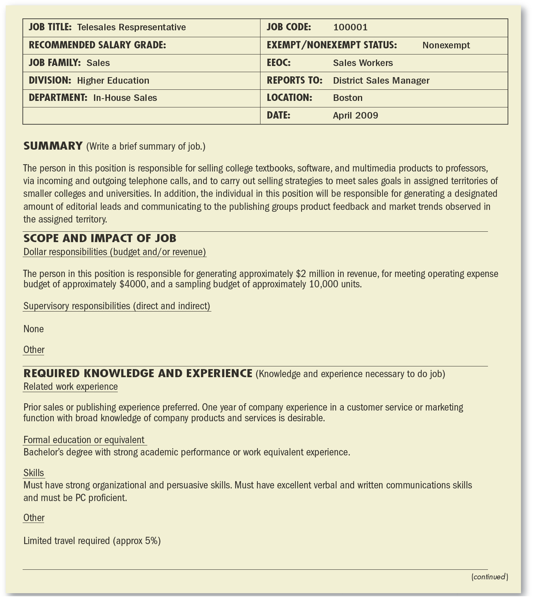
Sample Job Description
Notes:
Human Resources Management 12e
Gary Dessler
Copyright © 2011 Pearson Education
4–<number>

Slide 19
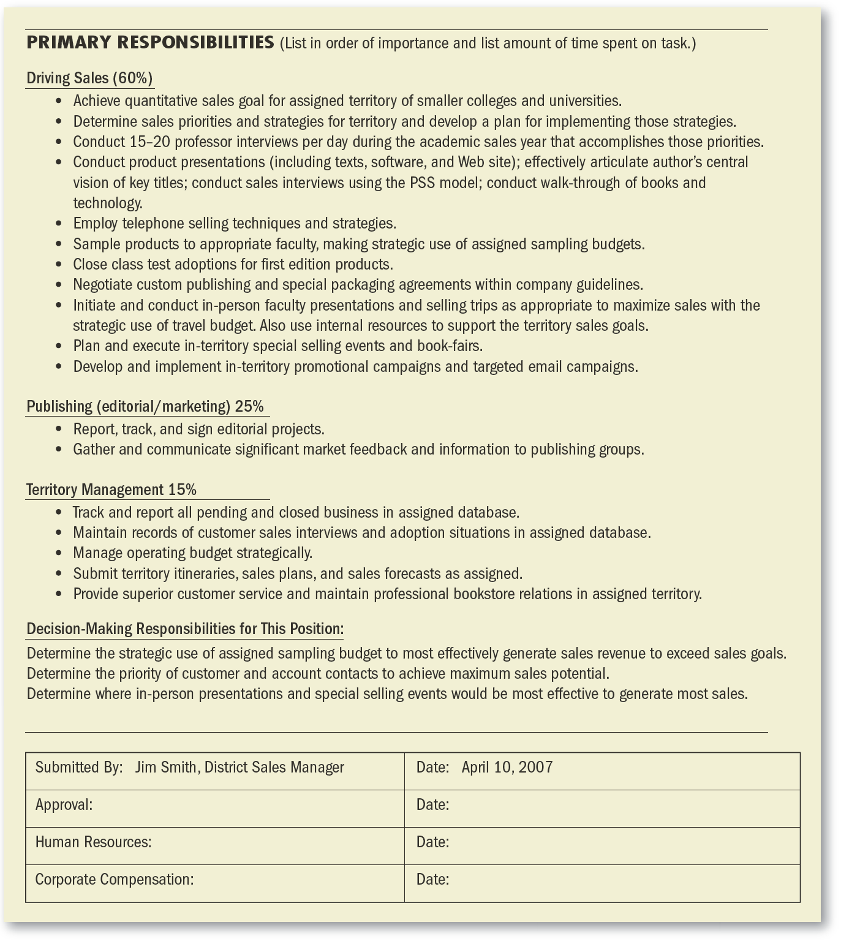
Sample Job Description (cont’d)
Notes:
Human Resources Management 12e
Gary Dessler
Copyright © 2011 Pearson Education
4–<number>

Slide 20
Class Activity
Write job description and job specification of your own or any other Job, may be hypothetical, as per sample format.
Notes:
The incidence of both lower incomes due to economic crisis and persistent high food prices has proved to be a devastating combination for the world’s most vulnerable populations.

Slide 21
Thanks
Notes:
The incidence of both lower incomes due to economic crisis and persistent high food prices has proved to be a devastating combination for the world’s most vulnerable populations.

